Slide 1

The Wifi Judge
By: Armontae Harris

Slide 2
What is it?
The Wifi Judge is a small device that shows you the strength of the nearest Wifi signal. It prioritzes the closest and strongest signal so you never have to guess which Wifi is best again.

Slide 3
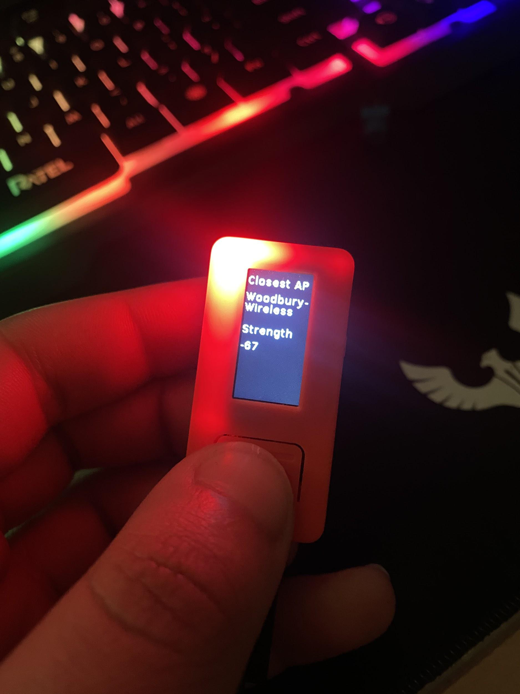
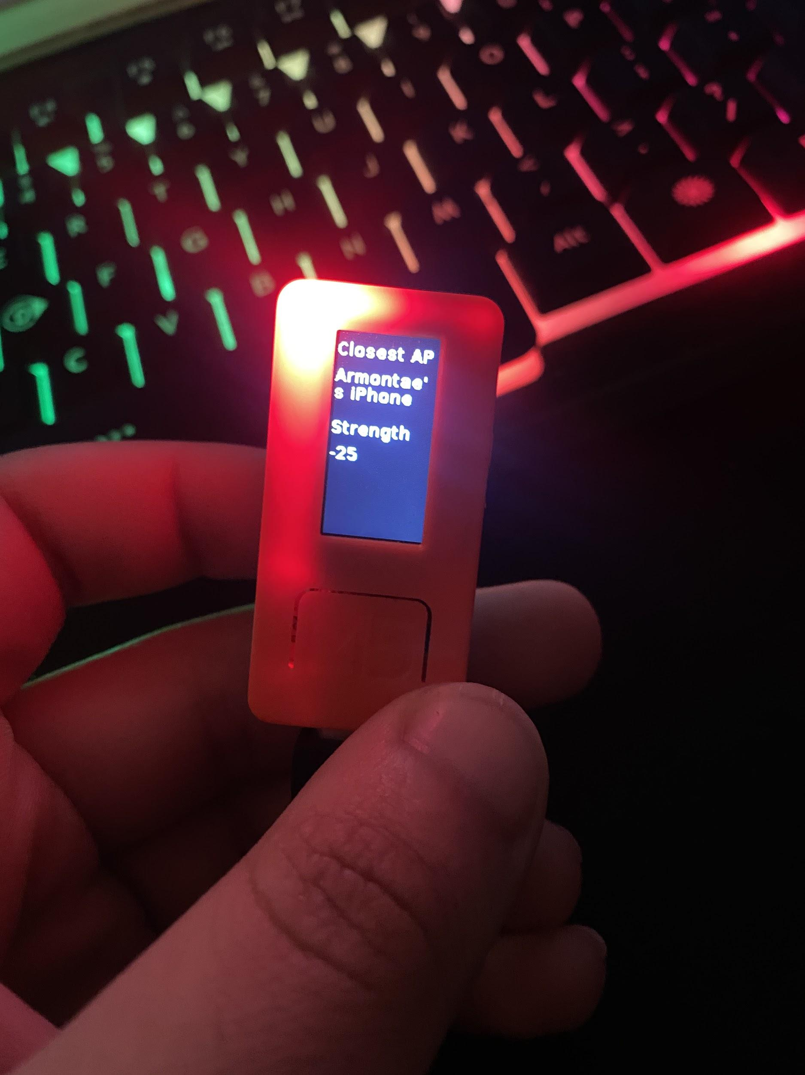
Documentation
School Wifi (Terrible)
Portable Hotspot (Better but inconsistent)

Slide 4
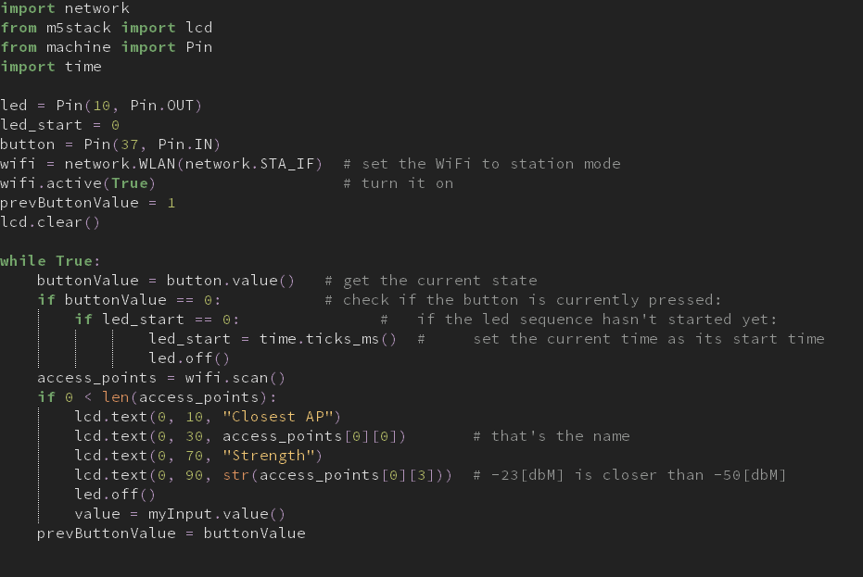
Code

